Slide 1



A GENTLE INTRODUCTION TO ANSIBLE
Anıl SelİM SÜRMELİ – ÖMER KARABACAK
_skynyrd
GUPGURU
skynyrd
omerkarabacak

Slide 2


Red HAT-2013
open-source IT automation engine
WHY?
- Infrastructure as a service (support for cloud apps)
- agile app development thru the devops practice
- service orchestration thru it process automation

Slide 3




Python | Ruby | Ruby, Erlang
SSH | SSL (Client - Server) | SSL (Client - Server)
Playbooks | Recipe | Manifest
Easy | Challenging | Challenging
AnsibleWorks | Opscode | Puppet Labs
2013 | 2009 | 2005 / 2011
Evernote, Rackspace | Facebook, Ancestry | Ebay, Google, Disney
GPL | Apache | Apache
YAML | Ruby / DSL | DSL
Jinja2 | ERB | ERB
Free open source version | Free open source version | Free open source version
AWX free to 10 machines | Enterprise free for 5 machines | -
$100-$250 per machine/year | $300 per month for 50 machines | $100 per machine/per year

Slide 4
Simple use
Modular
Great community support
Minimum dependency

Slide 5
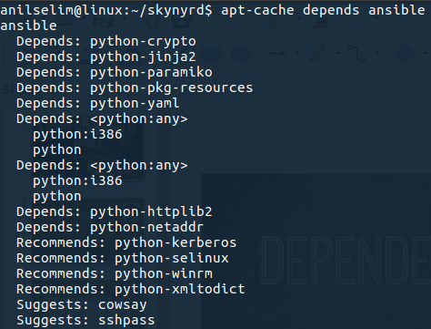

Dependencies:
On target hosts:

Slide 6

steps for simplest use case

Slide 7

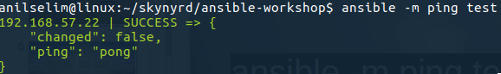
APPLY COMMAND:
ansible -m ping test

Slide 8
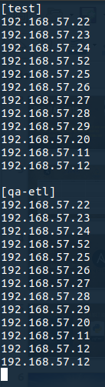
PREPARE HOSTS FILE
[ group-name ]
Ip-addr or host name

Slide 9

THAT SIMPLE?

Slide 10
PLAYBOOKS
Ansible’s configuration, deployment, and orchestration language.
Yaml, plays for different groups, roles.

Slide 11


Slide 12
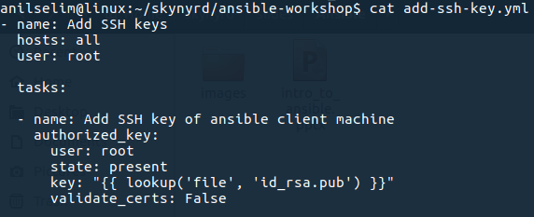
ansible-playbook add-ssh-key.yml

Slide 13
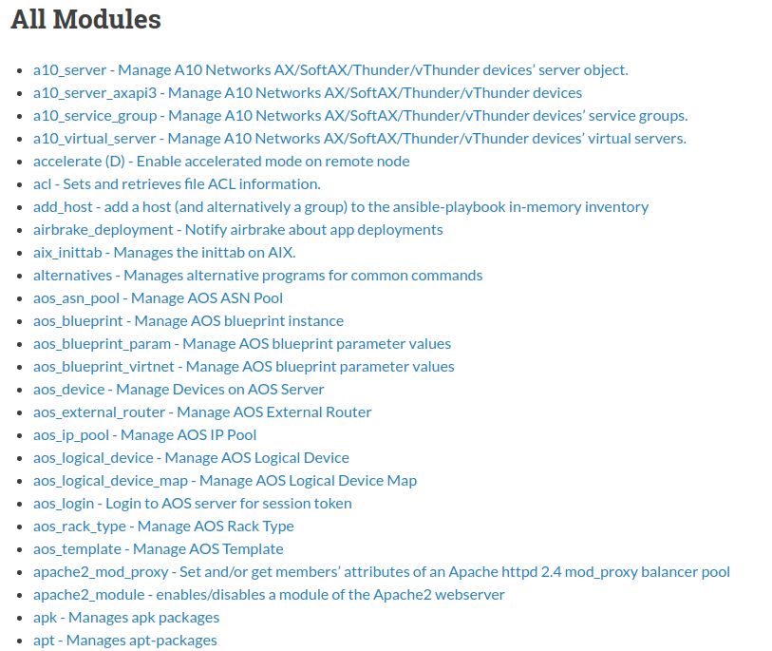
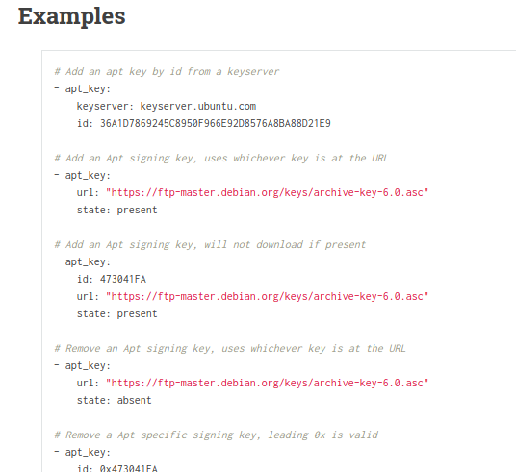
HUNDREDS OF MODULES
http://docs.ansible.com/ansible/latest/list_of_all_modules.html

Slide 14
LET’S DIVE IN…
Demo 0. Handling SSH Keys
Demo 1. Assign GoCD Agents
Demo 2. Setup Elastic Search Cluster

Slide 15

References
ANSIBLE OFFICIAL DOCS
http://docs.ansible.com/ansible/latest/
REDHAT ARTICLE
https://www.redhat.com/en/about/blog/why-red-hat-acquired-ansible
Hepsiburada team
https://github.com/hepsiburada

